Slide 1

Fundamentals of Software Engineering
Hashing
11.3

Slide 2
What and Why is hashing?
So far, we have successfully created data structures that have O(n) and O(log(n)) complexity.
Can we do better?
Can we get O(1) (constant time) complexity for a container?
If we have two employees with UIDs of 53374 and 81235 respectively, how can we get O(1) insert time to a structure?

Slide 3
Hashing
If we take our example of: UIDs of 53374 and 81235, we can apply the most basic hashing which is a modulo operator (%).
If we have a total hash table with indexes 0->N, we can apply a modulo of N+1, and these items are now directly inserted into an index. In an array, the operator[] is done in constant time.

Slide 4
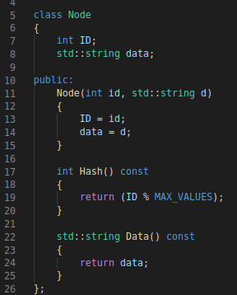
Hashable Node
Keep in mind that for a hash table, this is either an array or a dynamic array (vector). This allows us to maintain constant lookup using operator[].
This is the most basic type of node we may want to use, a Read-Only node.

Slide 5
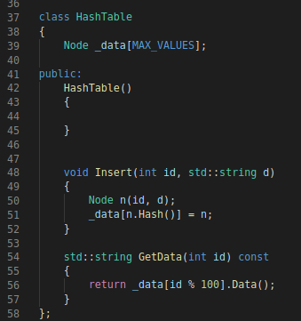
Hash Table
Using the actual hash table in its simplest form can be represented as shown.
However this implementation has a lot of holes.
1) What happens with the insert if that data already exists?
2) What happens with the data retrieval when that data does NOT exist?

Slide 6
Collisions
In order to work past this, we need to solve the collisions problem.
There are a few methods to avoid collisions:
1) A more robust hash function
2) A system that can spread the data around as needed.
Option 1) will obviously cost more per lookup, but still maintain the constant time.
Option 2) will decrease the single time lookup, but will introduce a loop that has the potential to introduce an Order of N to the lookup table.
The main goal of hashing and hash tables is to minimize the chance of collisions.

Slide 7
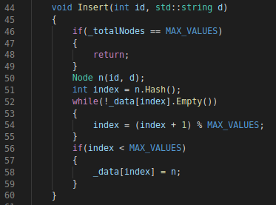
Linear Probing
Linear probing is the first and most simple way to solve this problem.
In this situation, if you are going to try to add something to a slot that already has a value, you increment by 1 until you find a slot where you can fill in the data.
What are the immediate problems you see here?

Slide 8
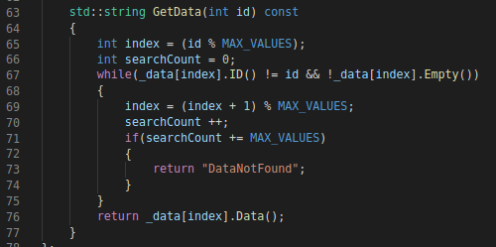
Retrieval
Retrieval now becomes much more complicated. You now need to check every node to verify the ID is correct.
Our new retrieval must also account for if our data does not exist.

Slide 9
Issues with linear probing?
Clustering will occur with linear hashing.
An ideal hashtable will have the items spread across the table evenly rather than in one section.
To get around this, you will have a proper re-hashing algorithm, where instead of just incrementing the value, you will add some sort of constant instead of just 1.
Rehash functions that implement this will not always eliminate clustering and will instead often times have localized clustering.

Slide 10
Quadratic / random Probing
Quadratic probing is an approach to alternate between adding and subtracting a value to the hash. This value is also squared.
This value is dependant on the number of things in the array.
Example: if the array size is a power of 2 (512) and your squared constant is 4, then this will not examine every value in the array.
If the size is a prime number, or some factor of a prime, then this will be able to reach every value of the array.
Random probing can also be used, but it will suffer from a slow down, especially when searching for the item.

Slide 11
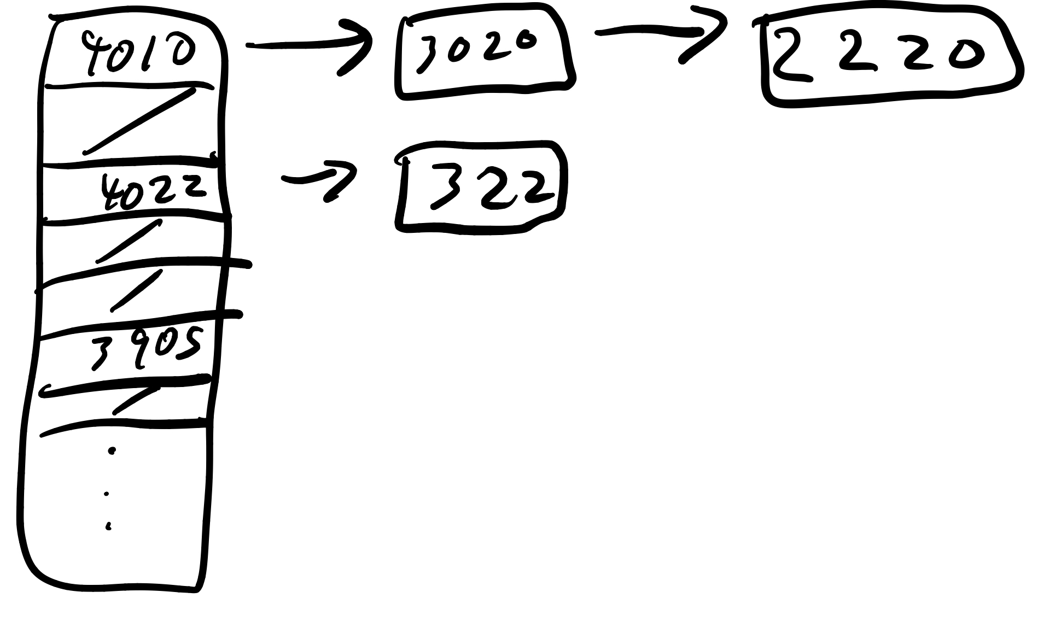
Buckets!
Another method is to have multiple keys of the same hash to exist in one bucket. This turns this node a linked list of possible nodes with that hash value.

Slide 12
A good hashing makes it better.
There are multiple methods of hashing to make this much better.
Find ways to group your data in a way to quickly eliminate a large chunk of data with the initial lookup.
You can also create hash functions on things like strings, that will guarantee a unique value for a string unless the values are the same.
Using Exclusive OR on various bits and adding them together to achieve a folding pattern will help produce various unique representations of values. This helps reduce large numbers down to a nice 8-bit number.

Slide 13
A note on complexity
The point here is to reduce the overall complexity of searching down to an array indexing. There is some overhead in generating the hashed value, but this time is consistent and constant no matter how many things are in the array.
This is how / why we maintain O(1) complexity.

